Slide 1
Development and Evaluation of Mixed Reality Educational Applications
Duan xiaoyun

Slide 2
Introduction
How to better apply virtual reality and augmented reality technology in teaching ？
how to make the advantages of intellectual technology and traditional teaching method complementary to each other has always been a problem to be explored by education researchers
Students could transform from passive receivers to active learners in autonomous experience process. This will be propelled by virtual reality technology and augmented reality technology.
MR exactly integrates the two technologies. Both of the two technologies emphasize simulated environment and users’ real experience and sense of participation

Slide 3
This thesis introduces the core technology and application situation of virtual reality and augmented reality in education and designs and develops three AR and VR education applications
VR art exhibition
AR 3d Coloring game
MR Chemistry Lab
Analyzes the education effects, user experience, equipment features, and implementation effects of these applications, expounds the advantages comparing with traditional teaching mode and the means to integrate virtual reality technology with education teaching, and talks about the basic principles of application design and interactive design
Some referential experience and methods in AR and VR education applications derived in the thesis provide useful references for the improvement and enhancement of the application of virtual reality technology and augmented reality technology in education teaching

Slide 4
Concepts
Virtual Reality - mainly refers to the three-dimensional VR based on head-mounted equipment
VR HMD + PC
VR HMD + Mobile
VR all in one
Augmented Reality - Augmented Reality overlays digital imagery onto the real world
Vision based AR
Marker-Based AR
Marker-Less AR
AR Kit and AR Core
LBS based AR

Slide 5
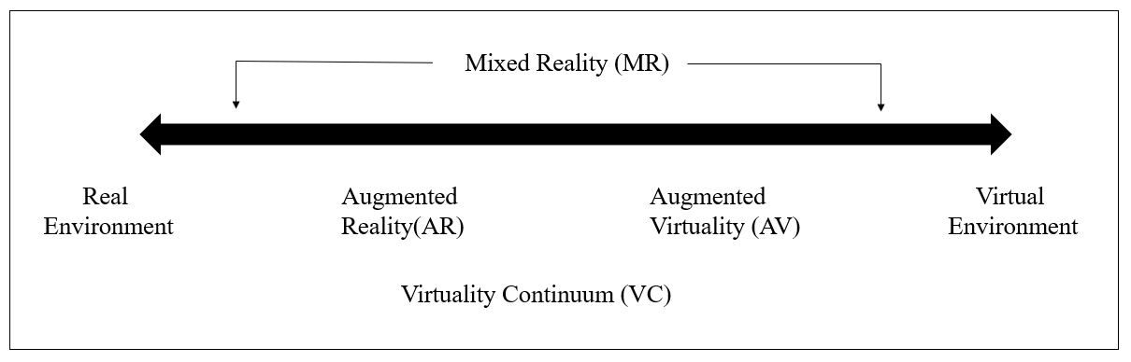
Mixed Reality
Paul Milgram and Fumio Kishino propose the reality-virtual reality continuum which respectively takes the real environment and virtual environment as the two ends of the continuum and defines the middle part as the “mixed reality

Slide 6
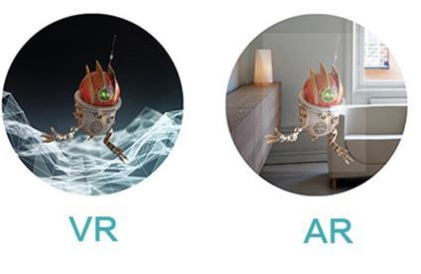
Distinguish and apply fields of VR and AR
VR places users in the virtual world while AR places the virtual world before the eyes of users.
VR creates a totally virtual world and separates users from the real world as shown in the left figure. The core problem is graphic calculation and immersive sense.
AR technology supplements virtual objects to the top layer of graph in the real world to augment and expand the information in the real world as shown in the figure. The core problem is graphic identification and trajectory.

Slide 7
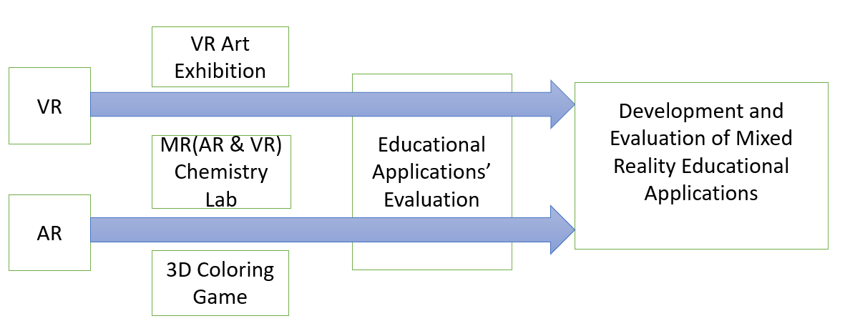
Research papers

Slide 8
Related Work
In spite of the short term of educational application of VR and AR technology, it coincides with the opinions of educational theories such as behaviorism and constructivism
In behaviorism theory, learning is stimulus-reaction connection constituted by the interrelation between knowledge and the outside world. The learning environment created by VR and AR could promote learners to seek feedback from the interaction with environment and retrieve subsequent action directives so that the connection between knowledge and reaction could be fully found
Considerable construction instrument systems and presentation areas provided by VR and AR virtual learning situation and learners’ subjective initiative coincide with Piaget’s conception and practice of “moving laboratory to the classroom” and the constructivism view of “learning is certain experience in real situation”..

Slide 9
Educational Applications types
3D Virtual Learning Environment
Sloodle (Second Life Object-Oriented Distributed Learning Environment)
AR Books
The Magic Book produced by Damine Hirst , By producing the 3D scene and animation in accordance with book contents and utilizing a special pair of glasses to make children see the virtual-real scene
Science Teaching
Beijing Normal University explores the influence of AR technology on Grade Eight students’ physics learning effects and deep cognition in the empirical research
AR and VR Language Teaching
AR school” English
VR Practical Training
Virtual Construction Site Program
Location Based AR Learning
Tourist attractions
Other applications
ChinAR

Slide 10
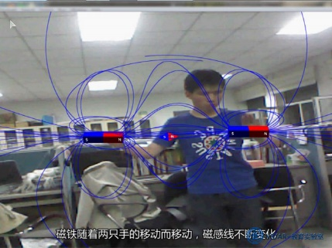
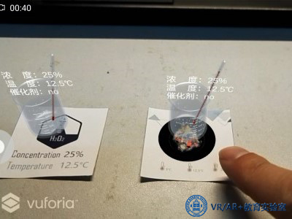
Cai Su et al realize the visualization of magnetic field by combining AR with Kinect somatosensory equipment. While learning the knowledge concerning magnetic field, students could have real-time interaction with equipment by means of gestures and therefore learn about the distribution and changes of magnetic field
Combining with PC or tablet teaching, AR technology could examine its influence on chemical reaction by controlling temperature, concentration, catalyst and other conditions in the means of natural interaction

Slide 11
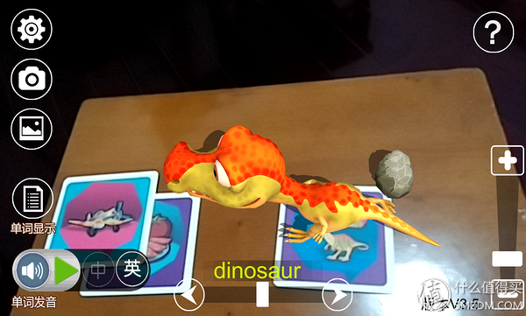
Scanning cards with tablet computers or phones to discern words, and present relevant pictures or 3D models with pronunciation could help children spell vocabulary and learn pronunciation

Slide 12
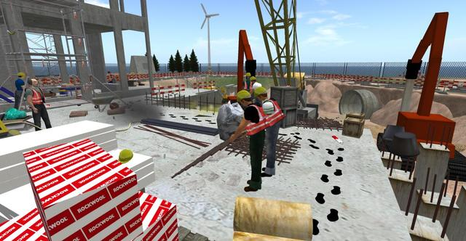
Virtual Construction Site Program
The introduction of knowledge in specific scenes outside the classroom endows educational experience with unparalleled values，This site exist severe security problems. Whereas, students could move around in the virtual environment and take photos in safe places. Such case is nearly impossible in real life. Out of this reason, this is in particular suitable for the virtual world. Personal virtual scene allows students to have experience in any field in work or life in the learning stage

Slide 13
Location Based AR Learning
Users could seek relevant architectures on the campus according to the real scenes captured by the camera during application use process. Once arriving at the site of target architecture, the camera could automatically discern the architecture information by capturing imaging and present the imaging to users as learning contents. Most respondents have mentioned that they could retrieve information at any time and place via phone and the combination of GPS technology and AR technology turns the search process and means of presentation more natural. It not only saves the procedure of manual input. The more important thing is that what you see is what you get. Besides, this software is acknowledged to be a feasible alternative of paper medium

Slide 14
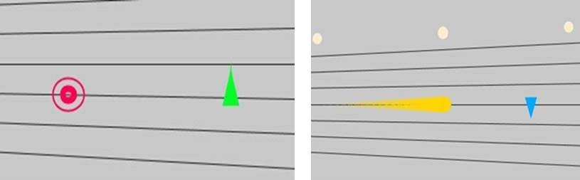
ChinAR
The application of ChinAR gives lots of “hints” to beginners by way of augmented learning technology, greatly lowers the introduction learning threshold, and combines with relevant musical theories at home and abroad to design a full set of interaction methods

Slide 15
No matter what technologies and what means have been employed, people should pay attention to the integration of learning contents and game elements. Throughout systematic teaching design, the learning contents could be rationally incorporated into the task of educational games under the instruction of learning theory. Situational setting makes for building up an immersive learning situation for learners and helping students have meaningful knowledge construction and exploratory learning

Slide 16
Interaction Design
Linguistic User Interface
Graphical User Interface
Multi-media User Interface

Slide 17
AR 3D Coloring game

Slide 18
VR Art Exhibition

Slide 20
AR 3D Coloring Game

